Slide 1

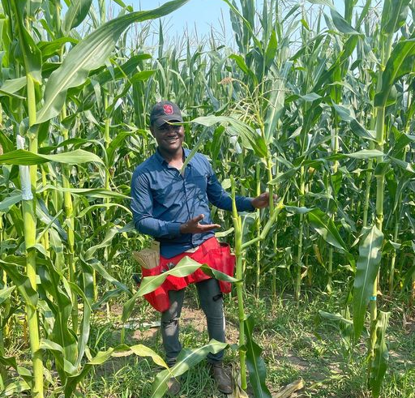
Discovering STEM in ACES Program (DSAP)
Mentor: Chris Mujjabi

Slide 2
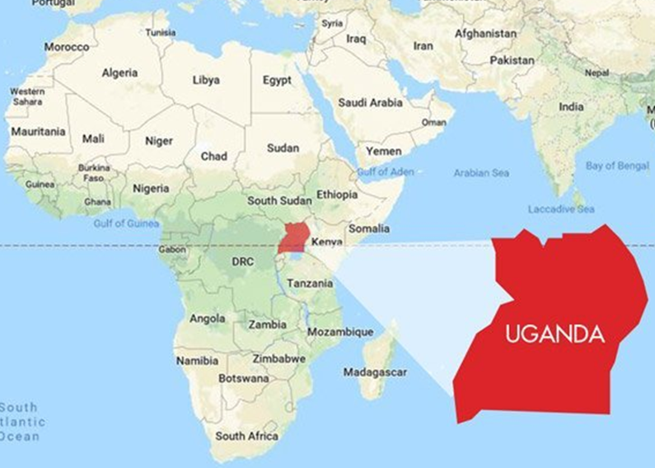



Born in Uganda
Undergraduate in Costa Rica
Bachelor degree in Agronomy
UIUC since 2018
Graduate Student
Research Assistant – Bohn Lab

Slide 3



Slide 4
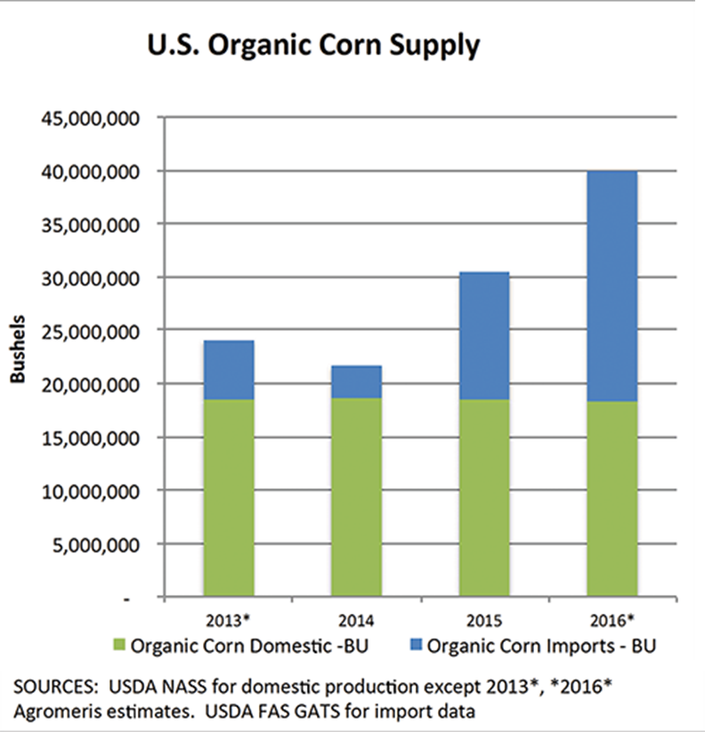
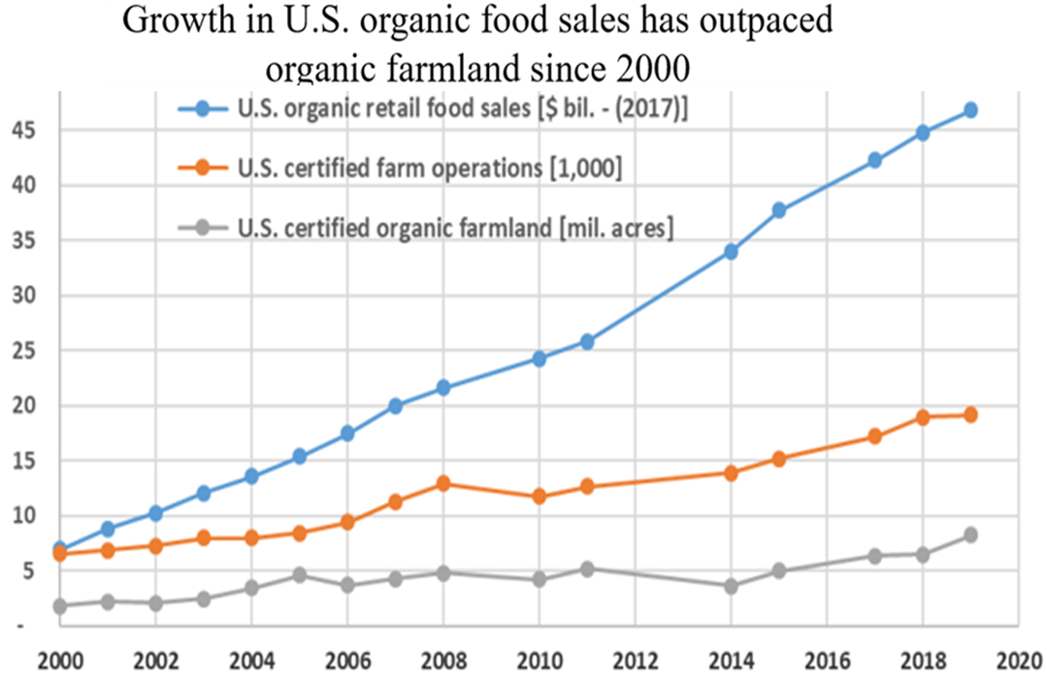
Breeding maize for organic systems.
(Midwest Organic & Sustainable Education Service, 2017)

Slide 5
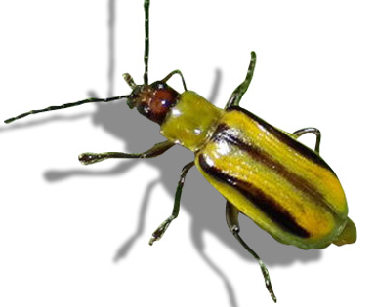
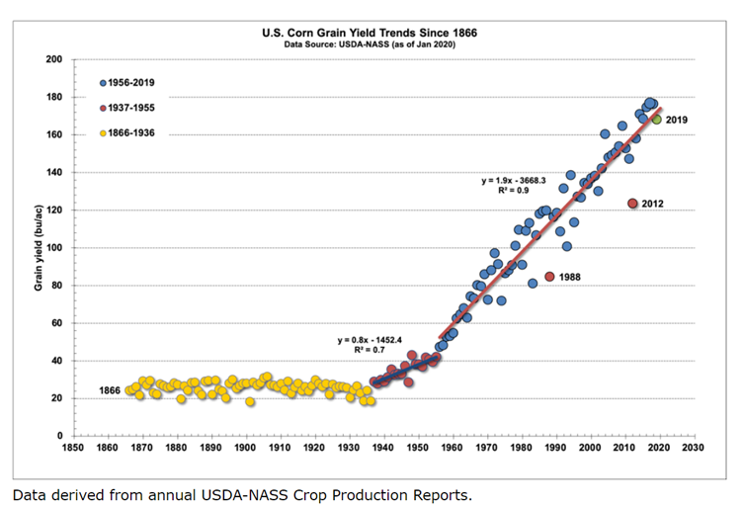

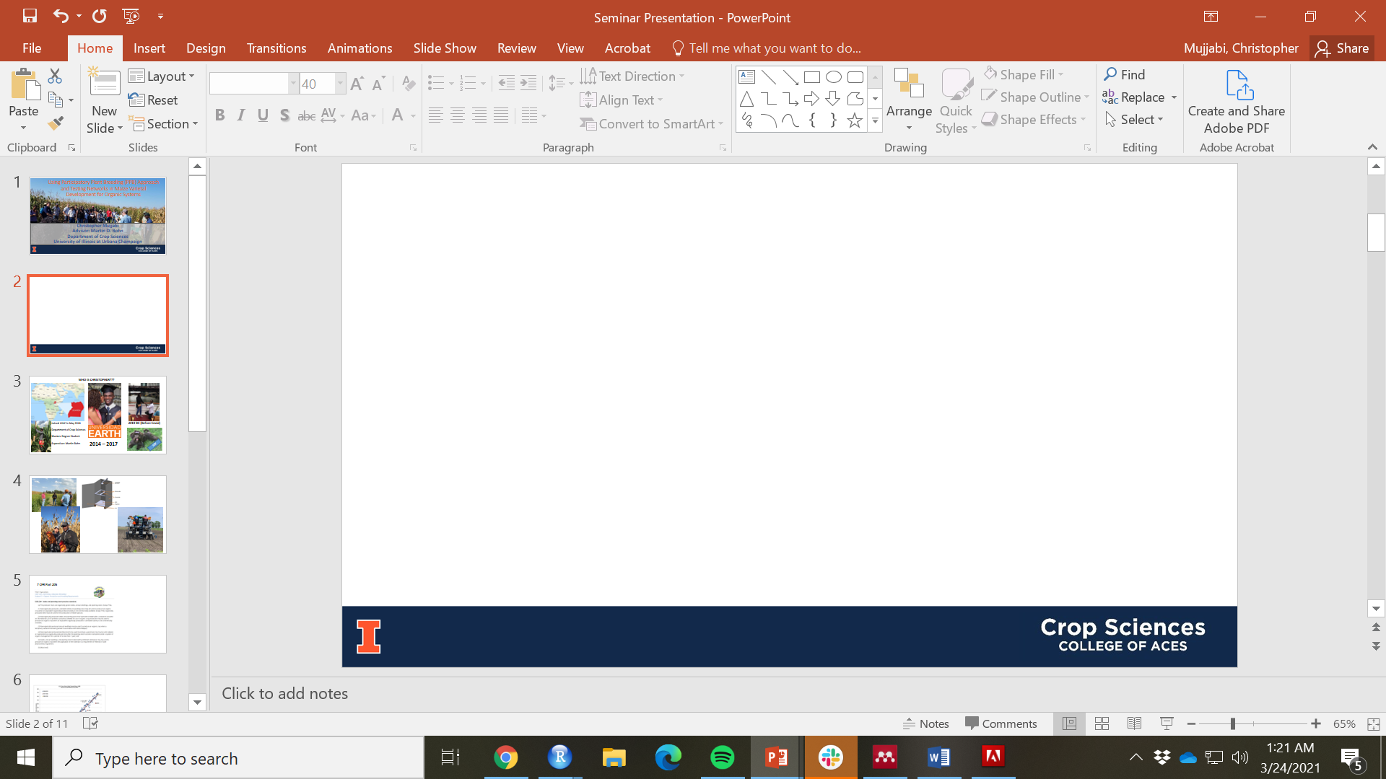

Traits for Organic Corn Ideotypes
1. Grain Yield
Historical corn grain yield trends show a linear increase of 134.5 kg/ha/year
Average organic yields are 68% of the average conventional yield (<130 Bu/acre)
2. Weed pressure tolerance
Competition for nutrients, light and water
100% yield loss if left uncontrolled
3. Resistance to pests
limited seed treatment, foliar fungicides and pesticides
15% corn yield loss
4. Nutritional value
Higher protein and carotenoid content
Essential amino acids like methionine for livestock
Controversial restricted use of synthetic methionine
5. Gametophytic incompatibility
Cross-pollination from conventional fields
Post-harvest rejection due to GMO contamination
Low yields due to late planting
Pollen exclusion mechanism with Ga1
6. Nutrient-uptake and Use efficiency
Grain yield per unit of supplied nitrogen
Organic sources and cover crops for nutrient cycling
NUE varieties increase protein content and yield response
Reduce N application requirements
(Nielsen, 2020)
Notes:
Varieties that tolerate high planting densities
43% of the total maize is feed for livestock and poultry and 11 percent for human consumption (2010)
N.U.E. is a product of nitrogen uptake efficiency (NUpE) and nitrogen utilization efficiency (NUtE).
The NOP regulations prohibit the use of GMOs as “excluded methods” under 7 CFR § 205.105: “
A variety of methods to genetically modify organisms or influence their growth and development by means that are not possible under natural conditions or processes and are not considered compatible with organic production. Such methods include cell fusion, microencapsulation and macroencapsulation, and recombinant DNA technology (including gene deletion, gene doubling, introducing a foreign gene, and changing the positions of genes when achieved by recombinant DNA technology). Such methods do not include the use of traditional breeding, conjugation, fermentation, hybridization, in vitro fertilization, or tissue culture (7 CFR § 205.2-Terms defined)
pectin methylesterase

Slide 6
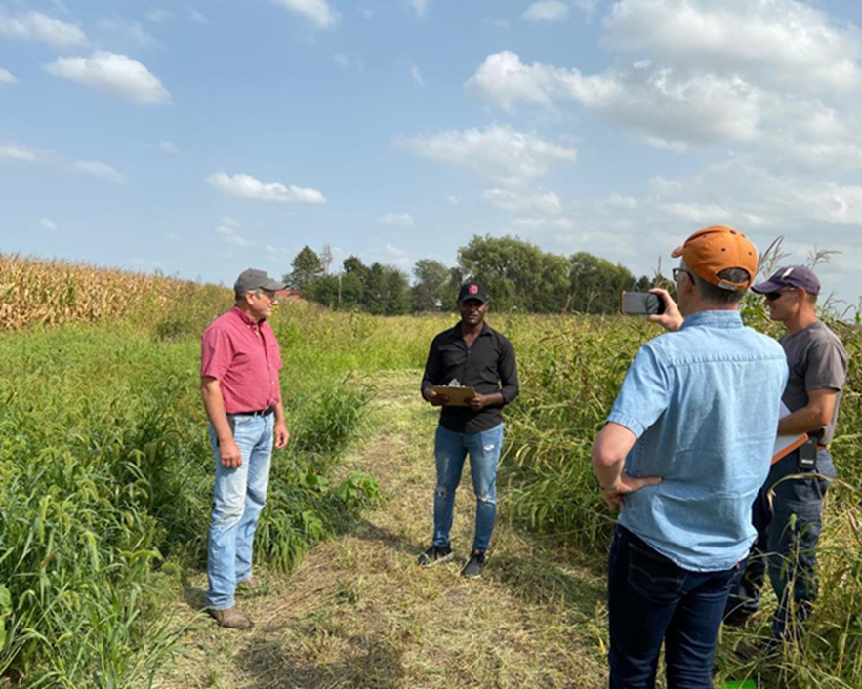
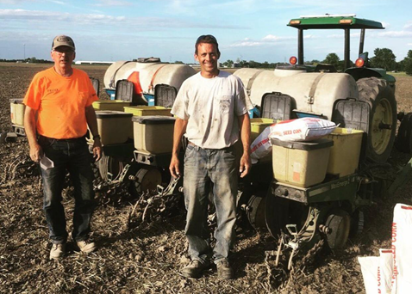
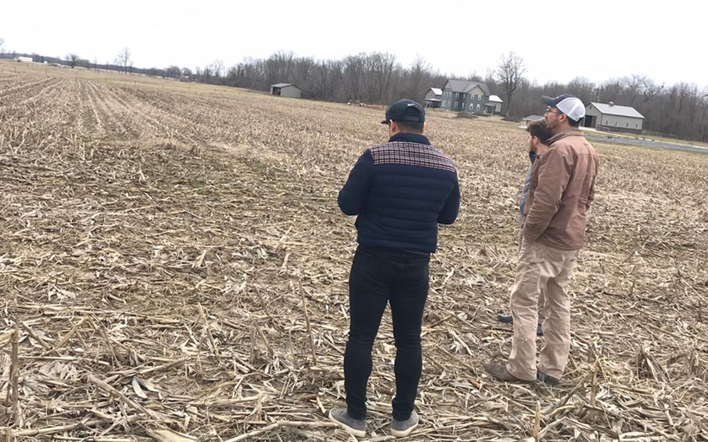
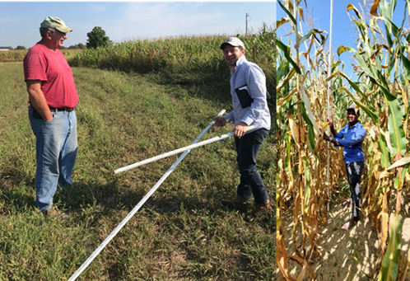
Participatory Breeding with a Variety Testing Network of Organic growers (2018 – 2021)
Organic farmers in IL, IN & WI
Evaluated performance of our germplasm under organic conditions
Identified traits of interest for organic farmers (weed pressure tolerance, grain quality, nutrient use-efficiency etc)
Baseline for new project focused on speed breeding for organics.
Use of winter-nurseries
Doubled haploids
Genomic prediction

Slide 7
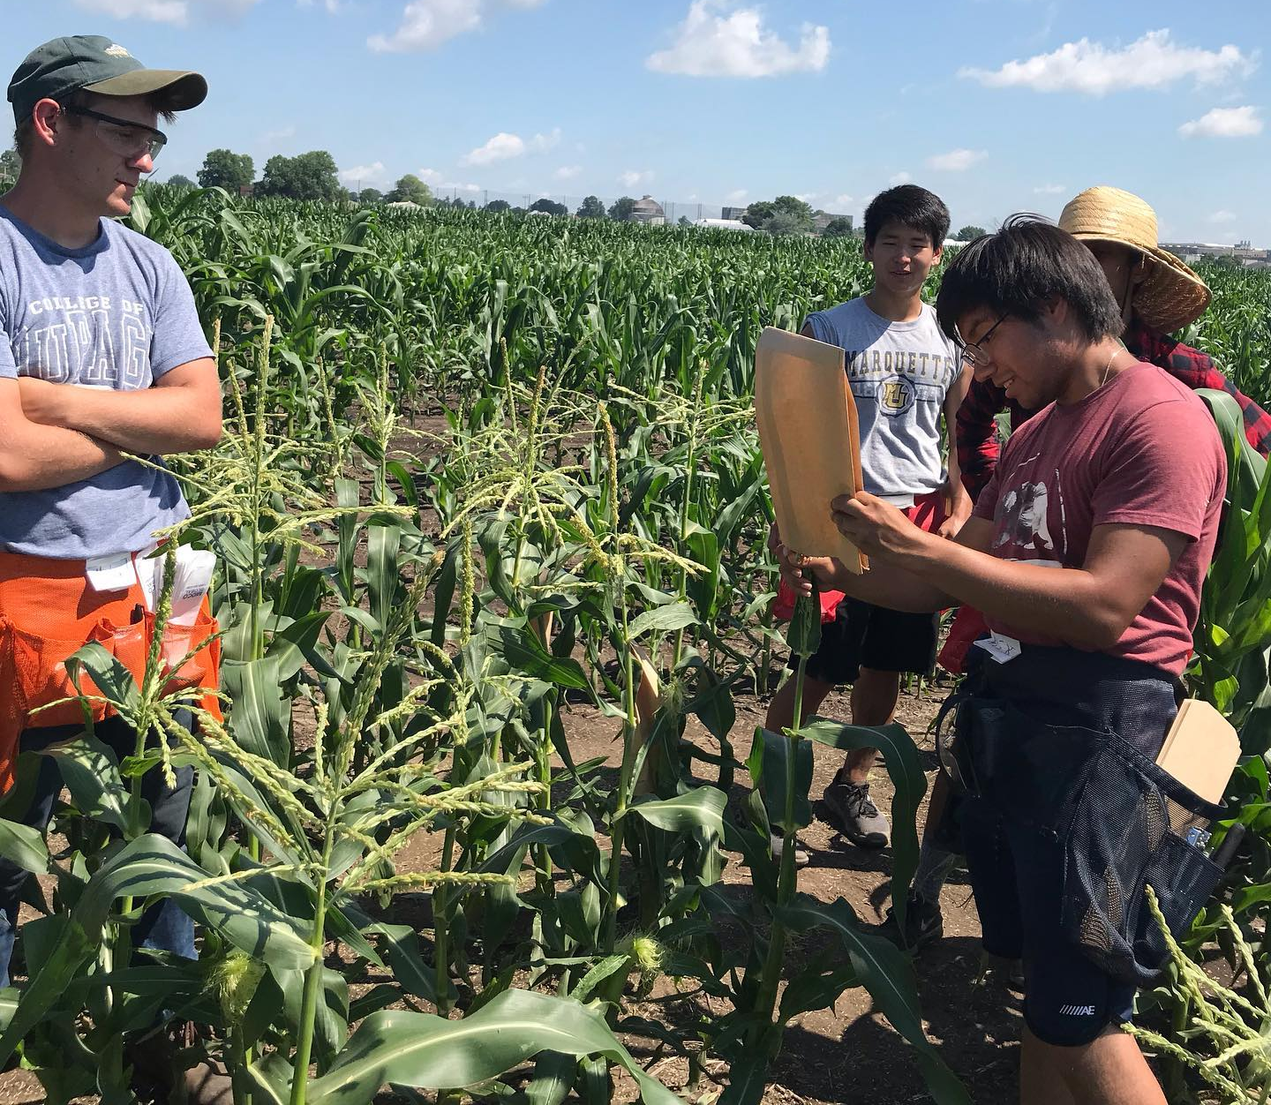
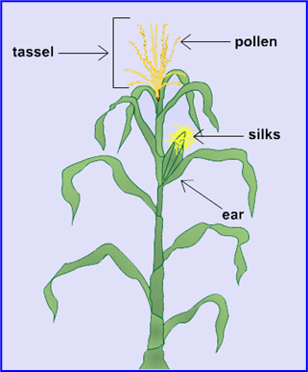
Maize Pollination for seed production
Learn the morphology of a maize plant
Cross pollination
Self Pollination
Difference between inbred and hybrids etc
Note: Practice in conventional nursery

Slide 8
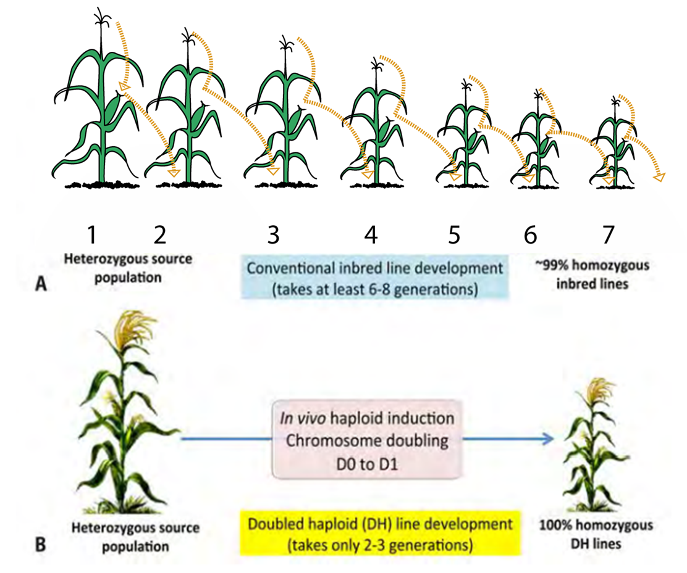
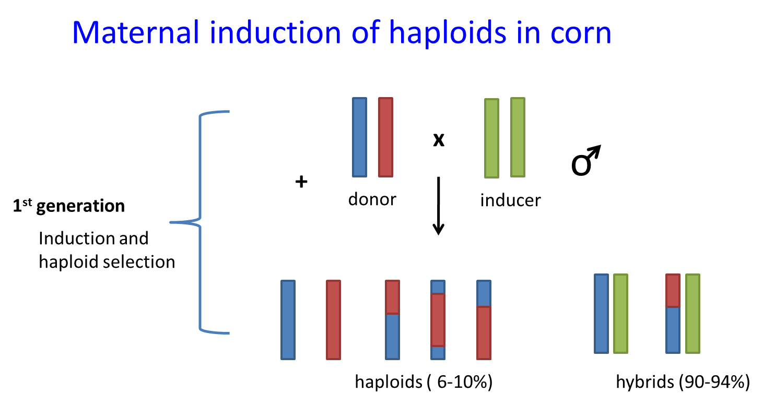
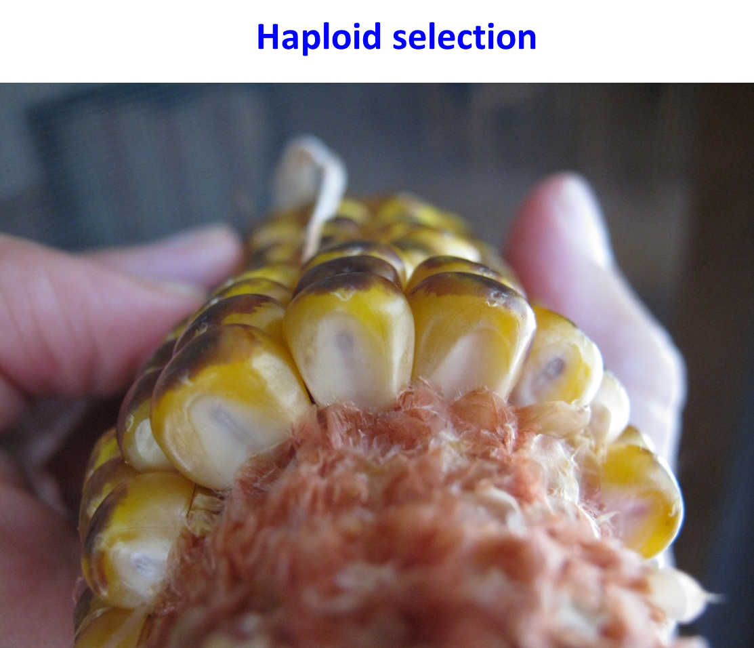
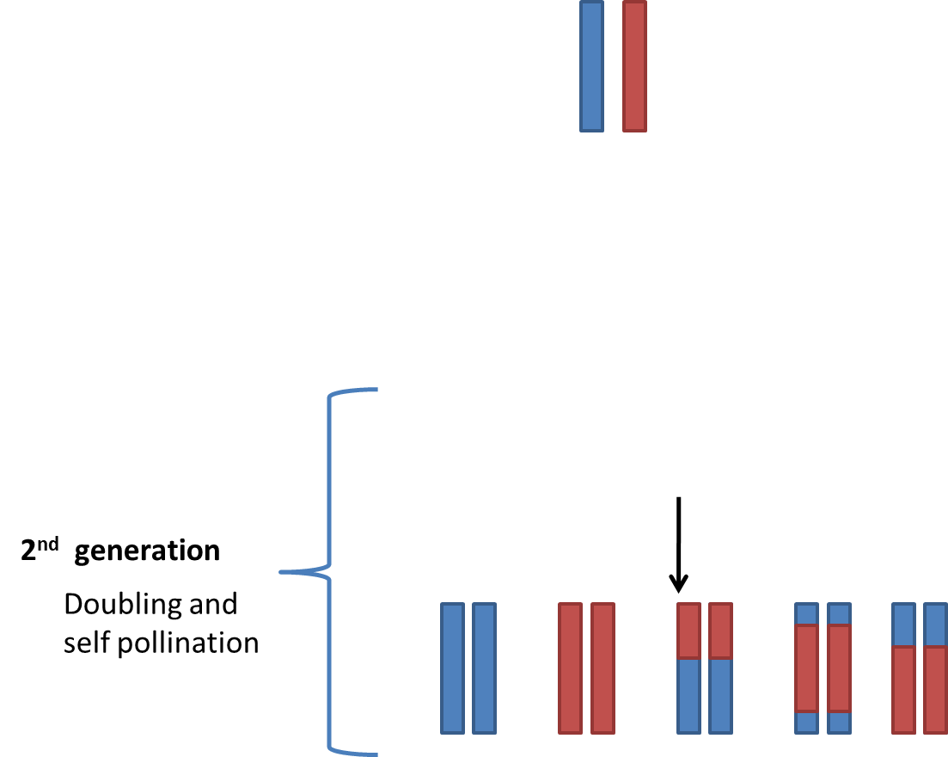
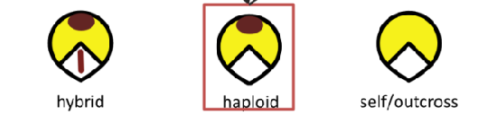
Introduction to Doubled haploid technique in corn breeding (Speed Breeding)

Slide 9
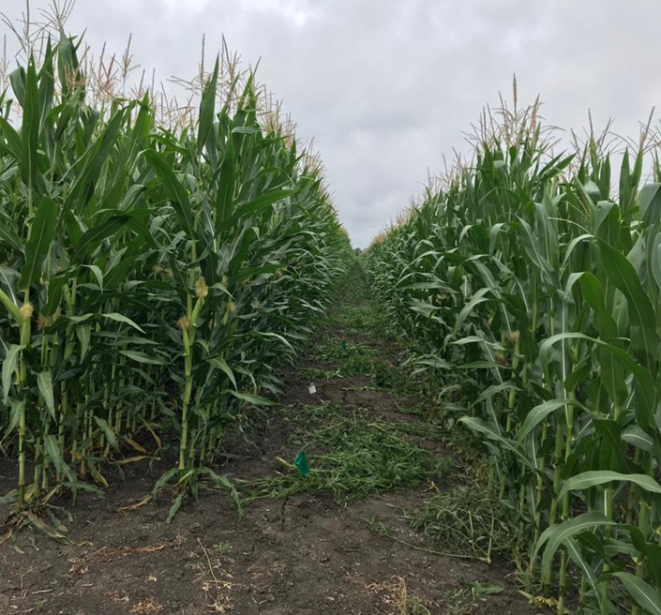
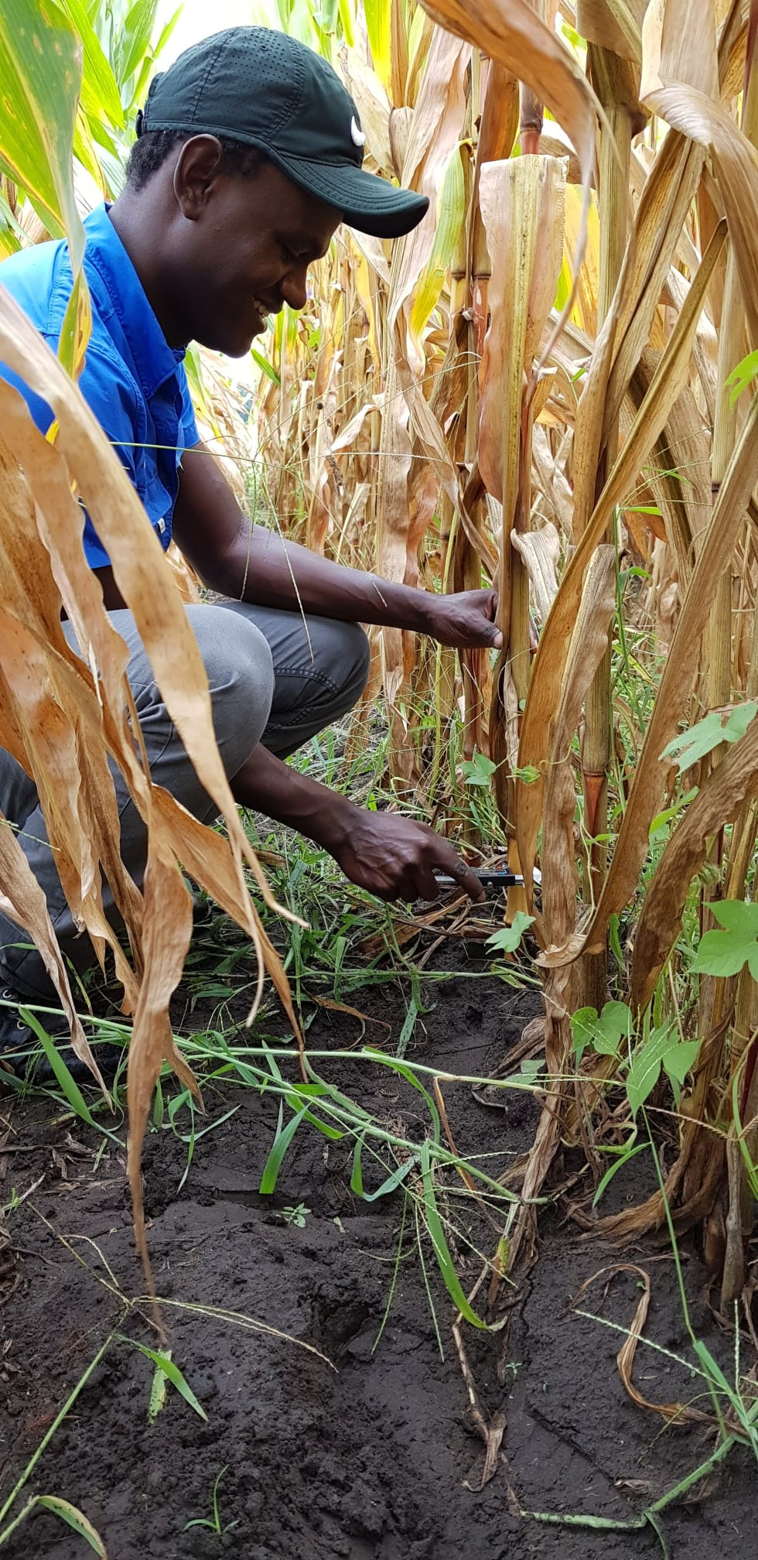
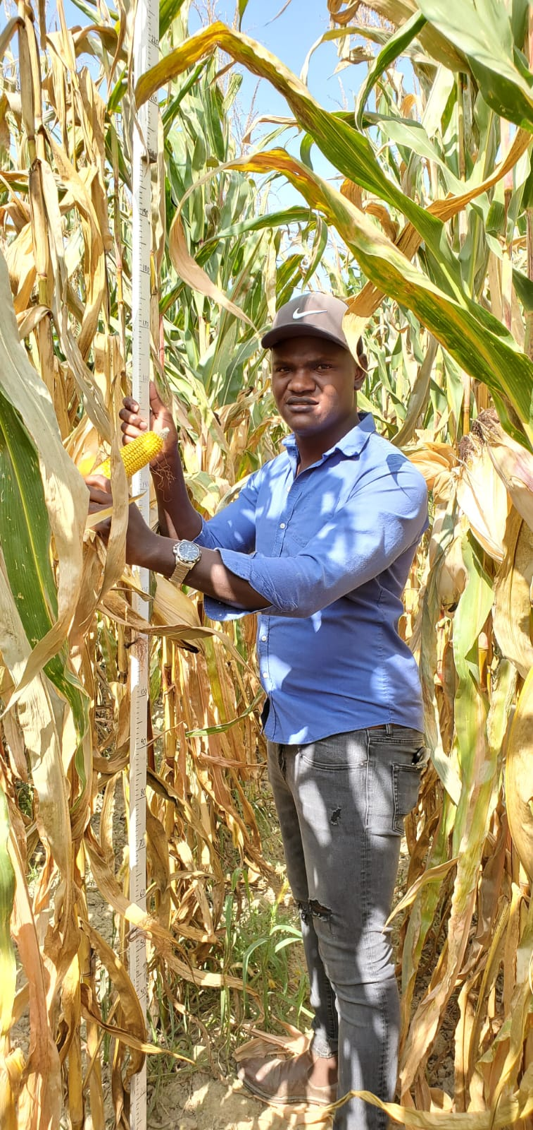
Phenotyping and Trait Evaluation (Data Collection)
Characterize phenotypic response of maize hybrids under varying crop rotation systems and soil nitrogen levels.
Nitrogen use efficiency

Slide 10

Introduction to Statistical Analysis and Hypothesis Testing
Use R Software to conduct a statistical analysis of the phenotypic data collected in the previous session
Test if N treatment influences hybrid performance. (Hypothesis testing)
Generate visual representation of our data (graphs, charts and figures in R)

Slide 11

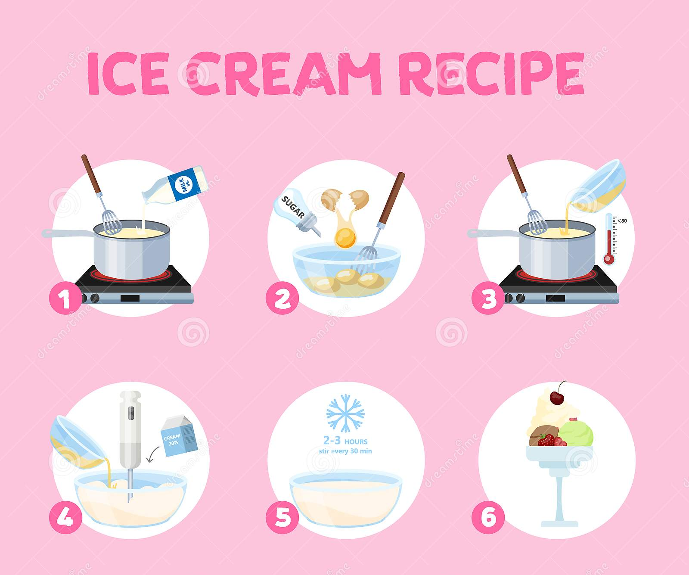
Additional Sessions
Undergraduate student panel
Ice cream experiment
Monday at 2 pm
Monday at 11 - 12 pm

Slide 12
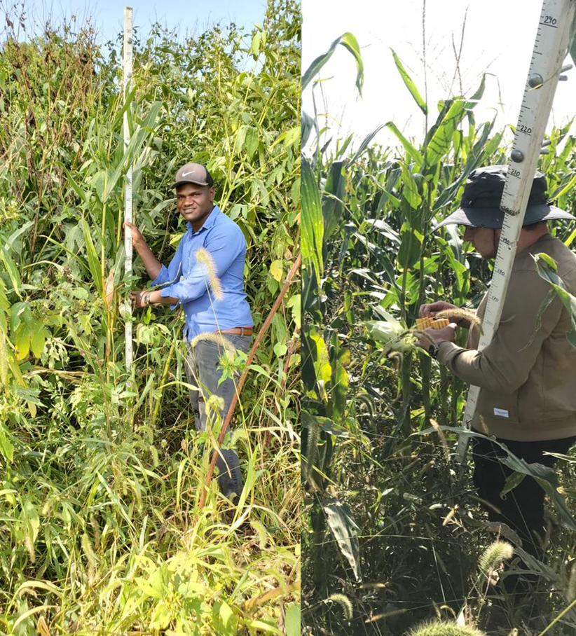
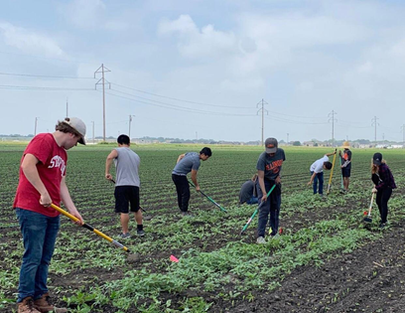
Weed management in Organic Systems

Slide 13
Friday Afternoon:
Working on the presentations
Feed feedback from students
Answer any pending questions

